Slide 1
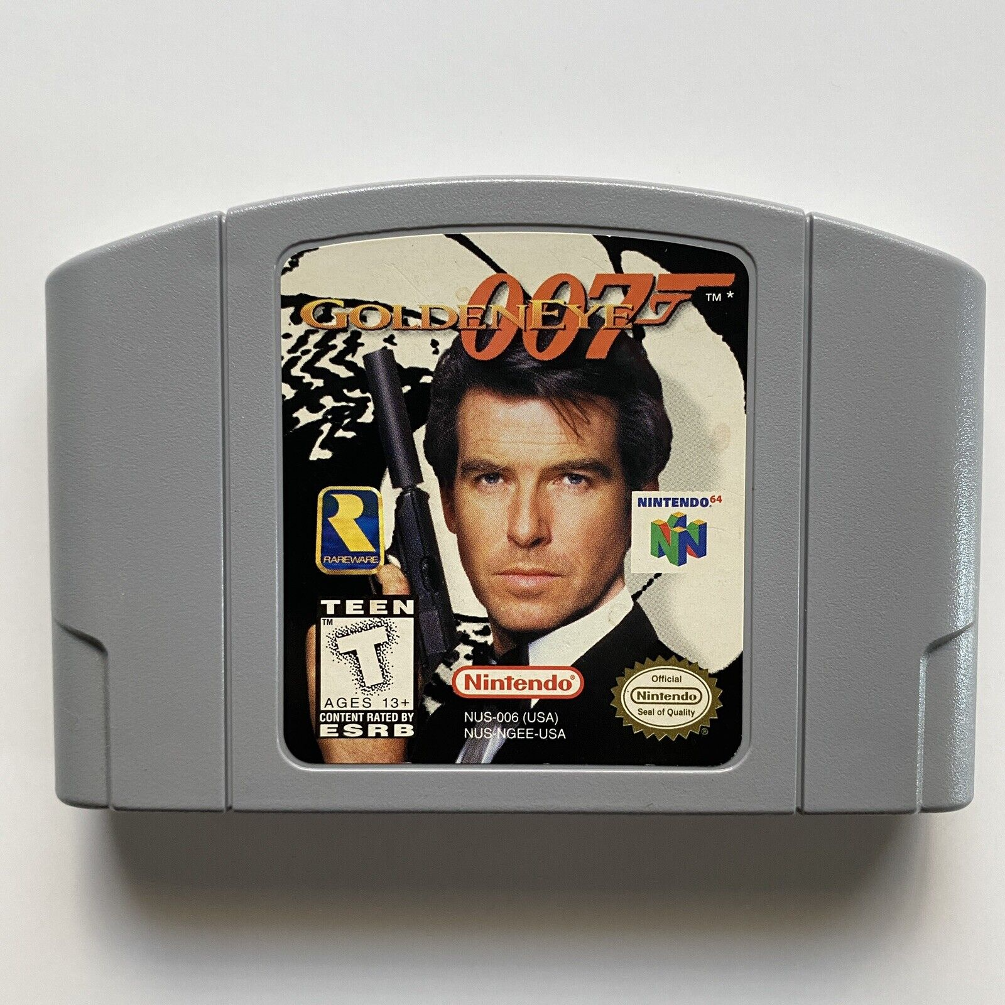


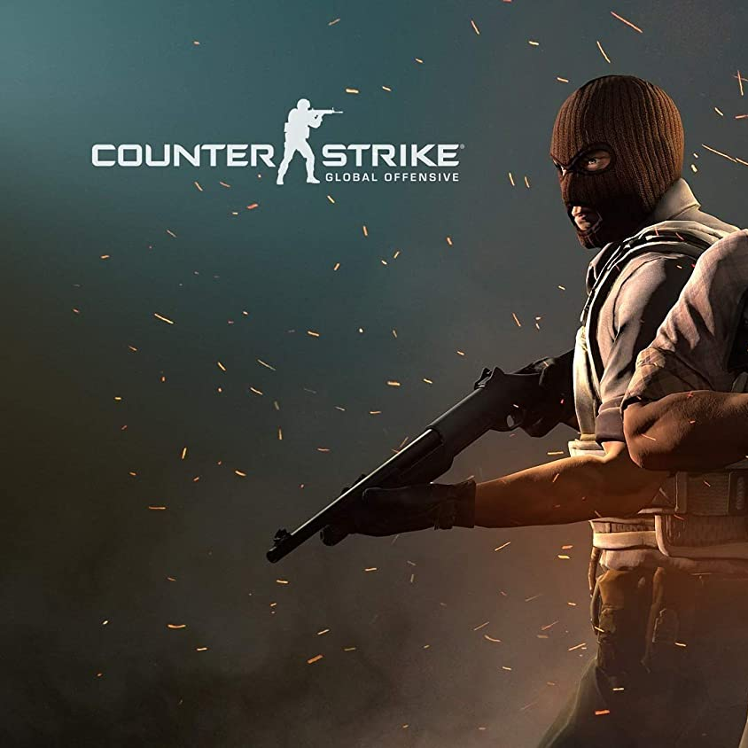



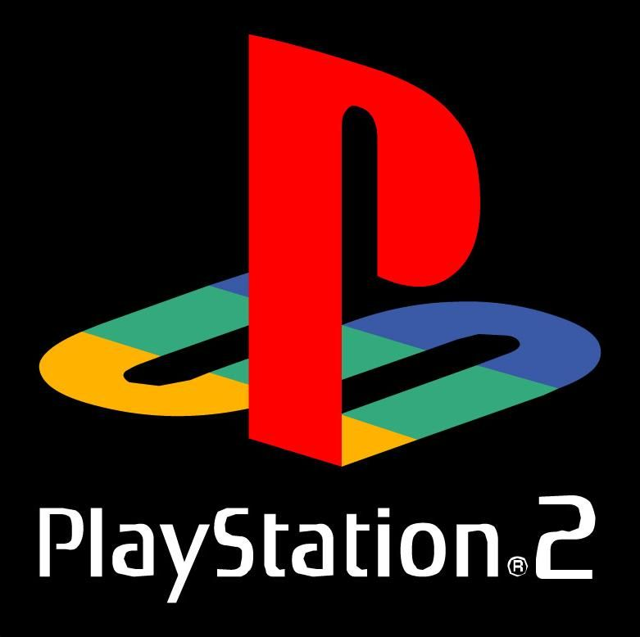
SO YOU WANNA GET INTO GAMES?
Breaking into the video game industry is difficult. Which games will sell, and which games will flop? It’s hard to know what will stick. Our goal is to help streamline the process of which video games are more likely to reach more viewers and get more gameplay and therefore make more profit.
Trevor Bridges
Trevor collected the Triforce as Link, saved a princess or two as Mario and Luigi, and fought in space as a Battletoad on his Nintendo and Super Nintendo. He didn't truly fall in love with video games, specifically FPS games, until 1997 on his N64. Trevor amassed copious amounts of successful missions as her Majesty's most trusted spy, 007. Goldeneye 007 changed Trevor's view on what a video game should provide and deliver and still uses Goldeneye as his golden standard for the basics of a good FPS.
Zac Lau
Zac grew up watching his brothers play the Gamecube and for the longest time they only had two controllers. Finally, though when the Xbox360 came out, it was his time to shine. Zac spent countless hours playing Modern Warfare 2 and Battlefield 3 with his friends after school and having the time of his life. Then in 8th grade a friend of Zac’s introduced him to PC gaming. He never turned back. Zac’s friends and he would play all the Garry's Mod game modes. Zac has put in over 2000 hours into Counter-Strike: Global Offensive. There Zac reached the top 3.195% of all players and its like having a badge of honor.
Phil Jaques
Phil was forever changed the day he received his original Nintendo. Although, at the time it was just referred to as "The Nintendo". Hours spent engaging in improbable acrobatics as a nimble Italian plumber smashing Koopa Troopas and banging his head against blocks for questionable flowers and mushrooms molded him into the absolute nerd he is today.
Jared Hubert
Jared's life changed forever in 2003 when he received his PlayStation 2. As a child of the 90s, he had grown up playing simple games on his Nintendo 64 and Game Boy, but the PS2 was a whole new world. The graphics were stunning, the gameplay was immersive, and the selection of games was endless. Jared spent countless hours exploring Spira as Tidus in Final Fantasy X, taking on giant bosses in Shadow of Colossus, or absolutely SHREDDING in Tony Hawk's Underground 2. The PS2 became his gateway to other worlds. To this day, Jared looks back with fondness and appreciation for the impact it had on his life.
Notes:
PHIL

Slide 2
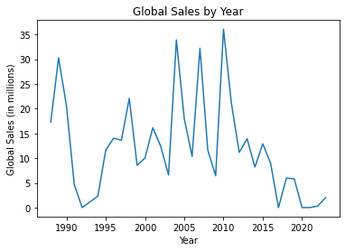
SALES BY YEAR
CRASH OF ‘83
The video game industry has experienced growth and decline over the years, with the dip in sales between 1990 and 1995 likely due to the video game crash of 1983. The large spikes between 2000 and 2010 may have been due to the popularity of consoles and the rise of online gaming.
PANDEMIC SLUMP
The low numbers in 2020 may be due to market saturation and the impact of the COVID-19 pandemic on consumer priorities and spending habits.
DIGITAL DELIVERY
Changing consumer preferences, such as the rise of mobile gaming and free-to-play games, have affected the video game industry. The industry has also seen a shift towards digital sales and subscriptions, which will require continued adaptation to remain successful.
Notes:
JARED

Slide 3
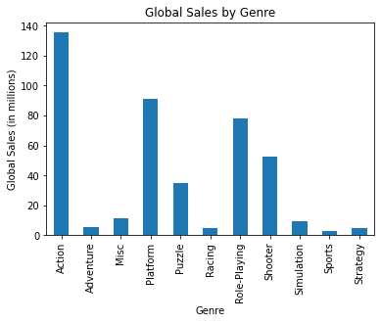
SALES BY GENRE
ACTION GAMING
Action games show the highest sales due to it being a catch-all for several sub-genres. Action games have also existed the longest, as a lot of retro games in the arcades were meant to be bright and exciting, leaving Action as the best genre option.
SPORTS GAMING
Our data set showed sports EXTREMELY low which leaves me to believe that it left out a significant amount of data on Madden and FIFA, which are two of the most popular games in the world when it comes to this genre.
COMBINE THE BEST
Bottom line - if you are able to make an engaging and accessible action platformer, you are much more likely to be successful with your game.
Notes:
JARED

Slide 4
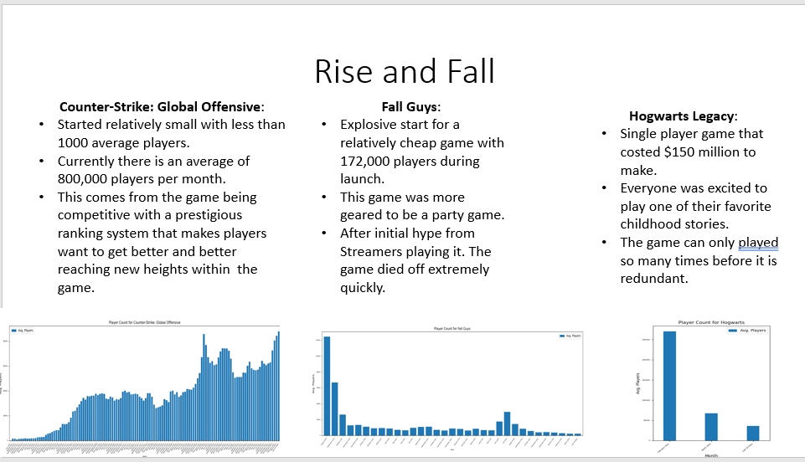
RISE AND FALL

Slide 5





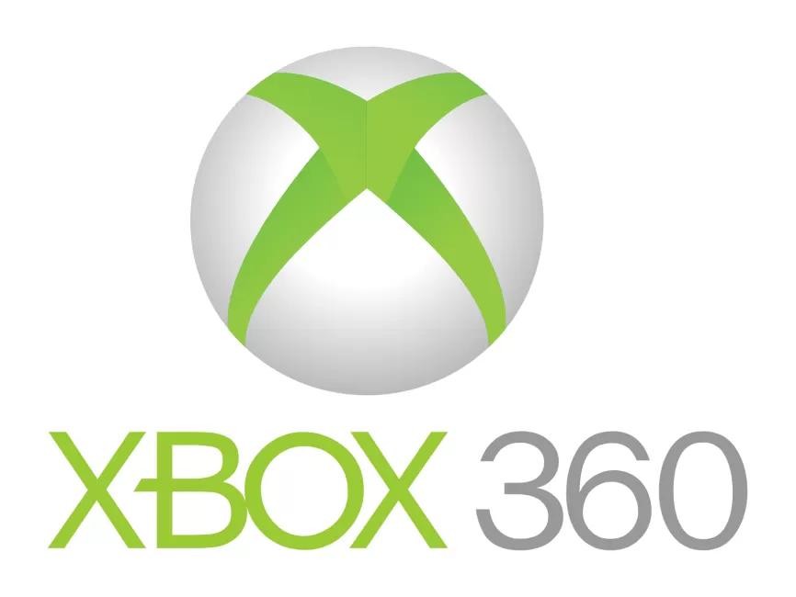

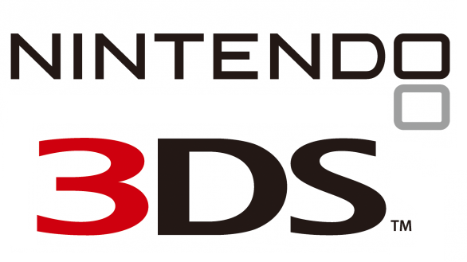
TOP PLATFORMS FOR EACH GENRE
For the 11 genres we have examined, these are the top gaming platforms for each one.
Action
RPG
Shooter
Sports
Racing
Strategy
Puzzle
Fighting
Platformer
Adventure
Simulation
= $10 Million
Notes:
ACTION / PS3: GTA V – 21.4 million
SHOOTER / X360: COD: Modern Warfare 3 – 14.76 million
RPG / PS4: FFVII – 9.72 million
PLATFORMER / NES: Super Mario Bros – 40.24 million
ADVENTURE / X360: Assassin’s Creed – 5.55 million
SPORTS / Wii: Wii Sports – 82.74 million
RACING / Wii: Mario Kart Wii – 35.82 million
STRATEGY / PC: Sid Meier’s Civilization V – 1.6 million
PUZZLE / GAMEBOY: Tetris – 30.26 million
SIM / Nintendo 3DS: Animal Crossing – 9.09 million
FIGHTING / Wii: Super Smash Bros – 13.04 million

Slide 6
GAME TIME!

Slide 7
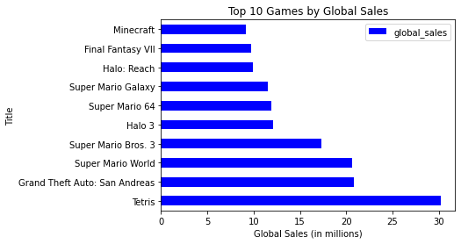
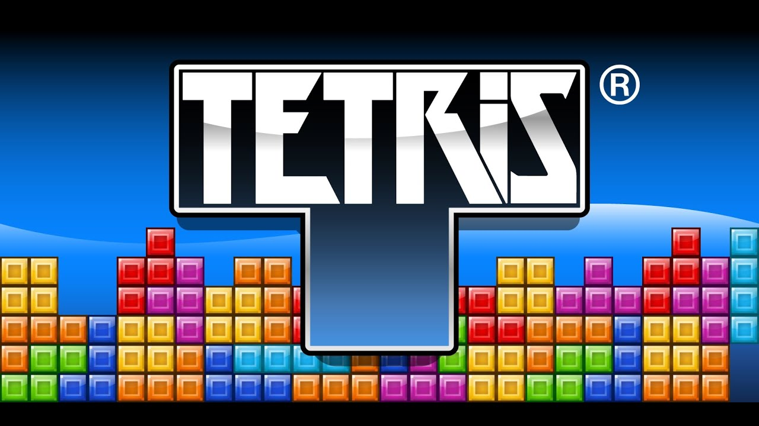
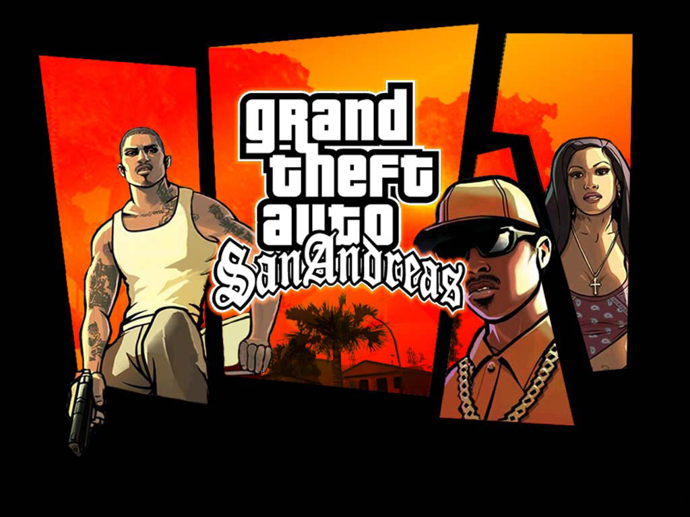
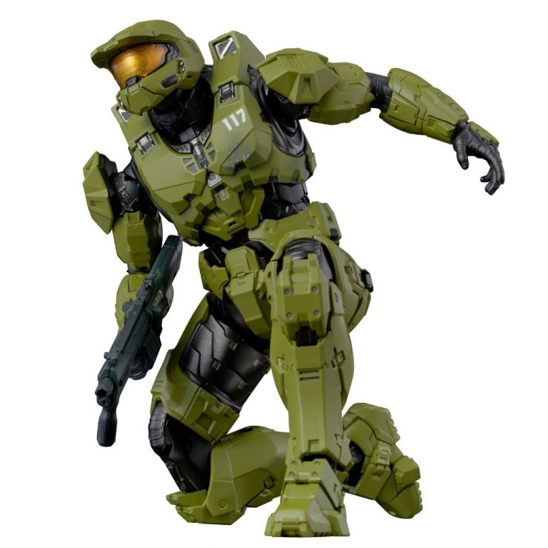
TOP 10 GLOBAL
While Nintendo holds the most entries in the top 10 with Super Mario Bros. proving why it is the classic, they can’t beat the juggernaut of GTA: San Andreas, nor Tetris. Two games could not be more different. GTA brought a gritty and adult story to gaming, putting the player in the role of anti-hero, and Tetris brought hours of addictive and nail-biting puzzle action to hundreds of millions of players since its inception.
Honorable mention goes to Halo, which has been a cash cow for Microsoft’s Xbox gaming system over several iterations.

Slide 8
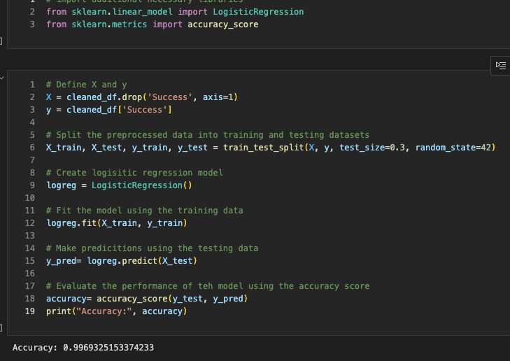
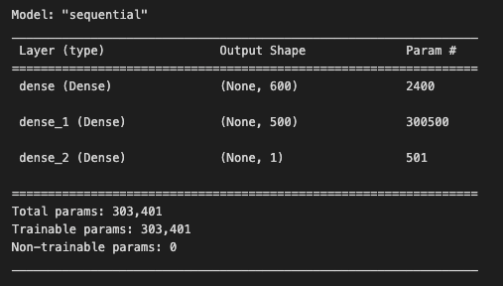
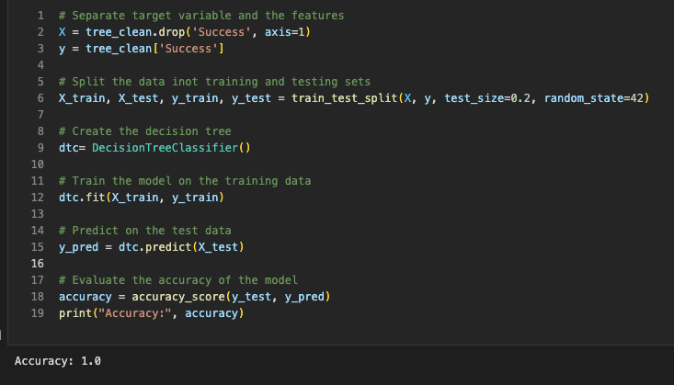

PREDICTIVE ANALYSIS
We used machine learning to create a predictive model for this data. Based on that model these are our observations.
LOGISTICAL REGRESSION
MODEL
To ensure the previous model’s accuracy we compared the same cleaned data using logistical regression. The cleaned data was winnowed down to 1086 rows and 5 columns. Our resulting accuracy score was 99.69%
Using the standard scaler to fit the data we used two hidden layers with “relu” as our activation layers and “sigmoid” as our output layer.
The resulting model gave us the following table…
DECISION TREE
As an extra layer of predictive assurance, we ran a Decision Tree model. The same cleaned data of 1086 rows and 5 columns were used in this model and yielded a 100% accuracy evaluation.
STANDARD SCALAR
After compiling, training, and fitting the data we found this model to be 99.13% accurate.
Notes:
Logistical regression and decision tree models utilized columns:
Rating
Number of Reviews
Plays
Playing
Results Explained: In our logistic regression model, we defined success as having a rating above 4.0. According to this metric, games that received a rating above 4.0 were 99.6% likely to succeed relative to our definition.In our Decision Tree model, the same rating above 4.0 was used as our cutoff value for determining game success. Our Decision Tree data predicted 100% rate of success for games receiving ratings above 4.0.The ScalerStandard Model utilized the following columns:
Rating
Number of Reviews
Global sales
Results explained: We defined success as global sales >3.5 (in millions) and created a new “success” column to distinguish the games based on this metric.According to this cutoff value, a game that has sales in excess of 3.5 is 99.13% to be a success relative to our definition
Thoughts for future analysis
Compare the global_sales column relative to the cost of production value
We could not find data on production costs in time
We could have calculated success based on the number of people playing relative to a game's original release date.
The prevailing thought being the more people playing over the long term the more successful the game is (reference Zac’s CS reference).
Could have filtered the games based on a percentage of total plays relative to the number of reviews.
I.e. games with less than 50% of reviews relative to people playing would not be utilized for future predictions.

Slide 9

THANKS FOR LISTENING!
Any questions?
???
???
???
???

